Slide 1
Project: Virtual Queue 2.0 Student: Kenneth Kon Michael Lazo Mentor: Bernard Parenteau
Project Plan
CIS 4911 Senior Project
School of Computing and Information Sciences
Florida International University
<02/02/2015>

Slide 2
My Role
Name | Roles | Tasks | Periods required | Key Phases
Kenneth Kon | • Developer • Scrum master (ALT.) • Test Engineer • Document Editor | • Project Status • Schedule/Task • Implementation • Testing • Project Documentation | 1/12/15 to 05/01/15 | All
Micheal Lazo | • Developer • Scrum master (ALT.) • Test Engineer • Document Editor | • Project Status • Schedule/Task • Implementation • Testing • Project Documentation | 1/12/15 to 05/01/15 | All
Notes:
Say developer and tester

Slide 3
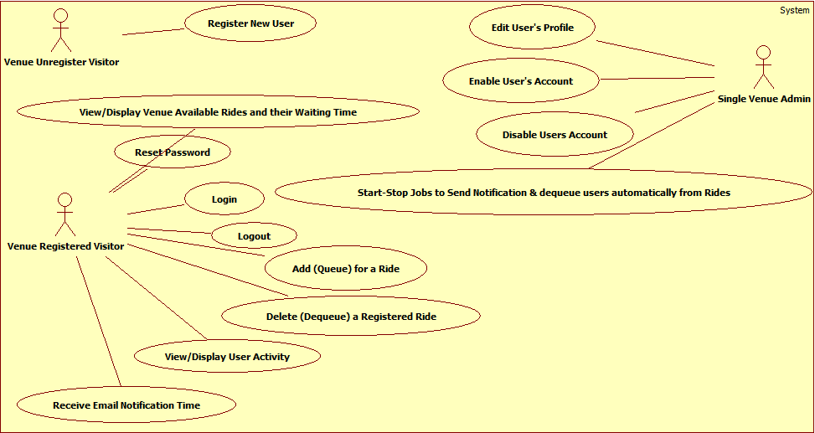
Use Case Diagram VQ 1.0

Slide 4
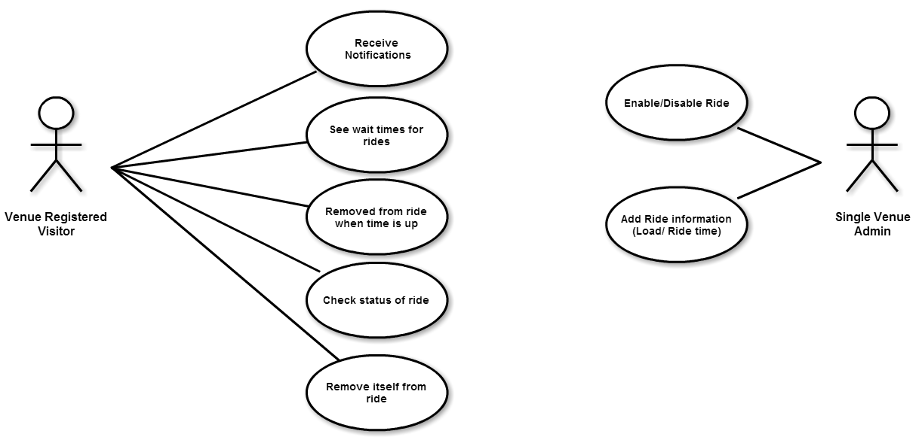
Use Case Diagram VQ 2.0

Slide 5
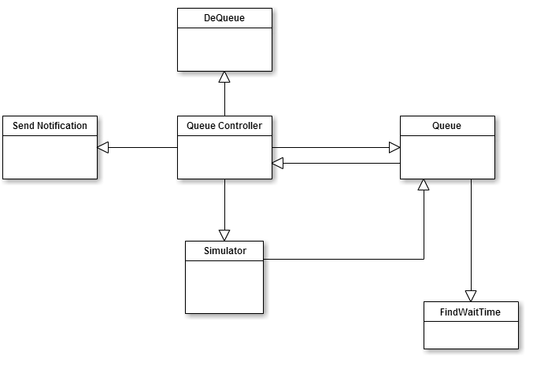
Class Diagram
Notes:
Ok, I knew what this means, a Class Diagram contains many details. A high-level class diagram is a simple class diagram reflecting only initial domain knowledge

Slide 6
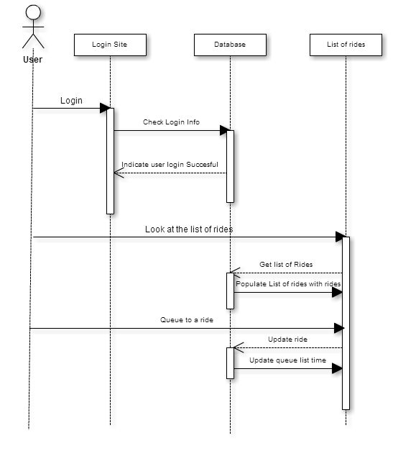
Sequence Diagram
Notes:
http://sourcemaking.com/uml/modeling-business-systems/external-view/high-level-sequence-diagrams

Slide 7
Architecture
For the Virtual Queue system a three tier and a multilayer architecture were used.
These will allow for horizontal scalability, which will let to multiple server instances to easily handle high traffic on the site.
Allows decoupling each layer using interfaces contracts only to communicate between them.
Notes:
Horizontal scalability is the ability to connect multiple hardware or software entities so that they work as a single logical unit. When servers are clustered, the original server is being scaled out horizontally.

Slide 8
Subsystem Decomposition
Six Main subsystems
User Interface
User Operation
Login/Logout Operation
Ride Operation
Queue Scheduler
Notification API
Notes:
User Interface: The user interface subsystem is composed of the web pages that the user will interact with in order to provide info about all rides offer in the venue.
User Operations: The user operation subsystem will group all the artifacts around the user business logic. Adim side
Login/Logout Operation: The login operation subsystem will provide system permissions to allow user or admin of the VQ system access to specific resources based on their permissions and roles they are assign to.
Ride Operations: The ride operation subsystem will group all artifacts around the ride business logic
Queue Scheduler: The queue scheduler subsystem will schedule jobs based on business requirements.
Notification API: The notification API subsystem will notify the user before their time for a ride they queued for approaches based on a particular implementation

Slide 9
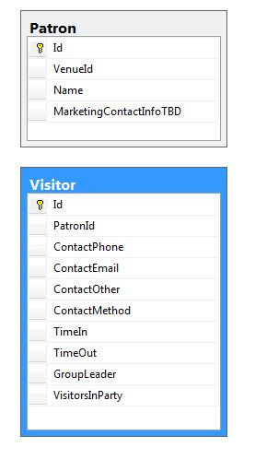
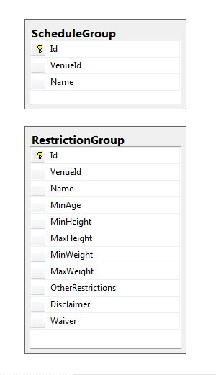
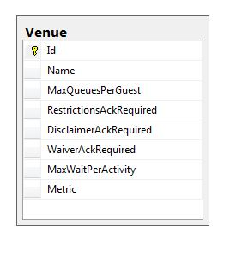
Persistent Data Management

Slide 10
Security/Privacy
Object Actor | Account | Profile | Ride
Authenticated User | Change Password | Update | Add/Remove from Queue, Check Ride Status
User Admin | Change Password, Access other Accounts | Update | Enable/Disable Ride, Add/Remove Ride
Anonymous User | Create

Slide 11
Project Plan Part 1
Task | Name | Start Date | Duration | End Date | Dependencies
T1 | Sprint 1 | 2/2/2015 | 11 | 2/13/2015
T2 | Milestone: Database Management | 2/2/2015 | 14 | 2/16/2015
T3 | Find Wait time | 2/2/2015 | 14 | 2/16/2015
T4 | Sprint 2 | 2/16/2015 | 11 | 3/27/2015 | T1
T5 | Milestone: Implement Queue | 2/16/2015 | 14 | 3/2/2015 | T2
T6 | Queue updates | 2/16/2015 | 14 | 3/2/2015 | T2
T7 | Sprint 3 | 3/2/2015 | 18 | 3/20/2015 | T4
T8 | Milestone: DeQueue | 3/2/2015 | 21 | 3/23/2015 | T2, T5
T9 | Status Request | 3/2/2015 | 21 | 3/23/2015 | T
T10 | Sprint 4 | 3/23/2015 | 11 | 4/3/2015 | T7
T11 | Milestone: Test Queue Controller | 3/23/2015 | 14 | 4/6/2015
T12 | Sprint 5 | 4/6/2015 | 11 | 4/17/2015 | T10
T13 | Milestone: Finalize Document and Presentation | 4/6/2015 | 14 | 4/20/2015

Slide 12
Project Plan Part 2

